Slide 1
Historical Background of Health System in India
Dr Daksha Parmar
HS142 Introduction to India’s Health Systems
Dept of HSS-IITG
8th September 2022

Slide 2
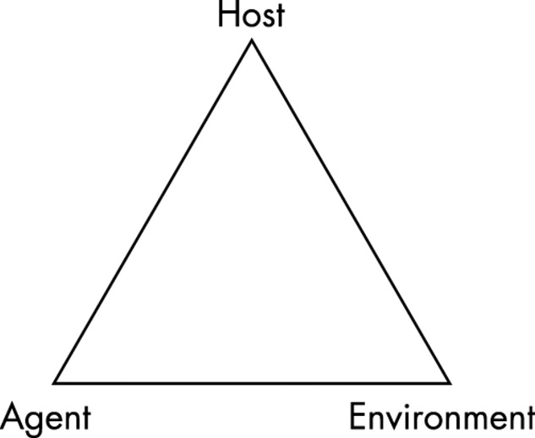
What are Communicable Diseases
A communicable or infectious diseases are caused by a transmission of a specific infectious agent or its toxic products, capable of being directly or indirectly transmitted from man to man, from animal to man, from animal to animal, or from the environment (through air, water, food, etc..) to man.
Three Things are Important: Agent, Host and Environment
The Epidemiological Triad

Slide 3
The Epidemiological Triad-Contd
Agent:
One which is capable of causing a disease.
Mainly includes viruses, bacteria, fungi etc.
The agents must produce infection, it must induce clinically apparent disease with severe manifestations
Host:
A host is one in whom the disease manifests. For example-Human being.
Place where agent can grow and multiply.
Age, sex, immunity determines whether the host is susceptible to a disease
Environment:
Physical: Air, water; biological-insects, rodents and social-socio-economic factors
Sanitation, temperature, air pollution, water quality, over-crowding and poverty.
Exercise: In case of Malaria-identify the host, agent and environment in
which it is widely prevalent.

Slide 4
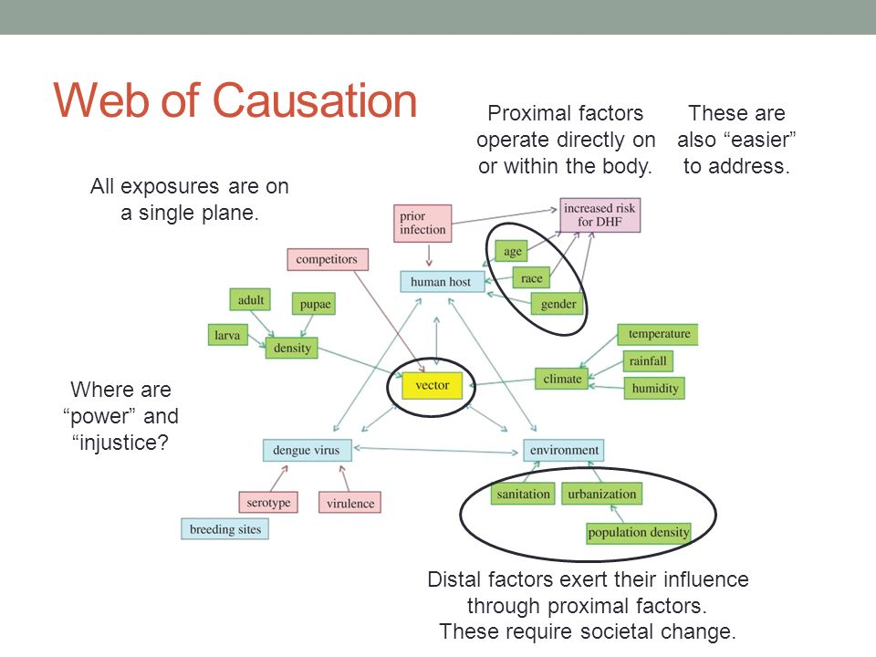
Web of Causation by Prof. Nancy Krieger

Slide 5
Endemic, Epidemic and Pandemic
Endemic: Disease or condition present among a population at all times.
It is the usual or expected frequency of disease within an area or population
Ex: Common Cold and Malaria in India
Epidemic: Occurrence of disease in “excess” of expected occurrence. Ex: Ebola outbreak in West Africa in 2016.
Pandemic: An epidemic affecting a large proportion of the population over a wide geographical area-nations, continents or the world
COVID-19, SARS, H1N1; HIV-AIDS

Slide 6
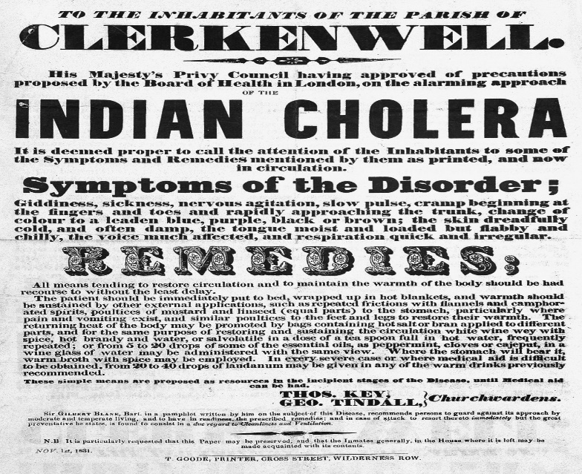
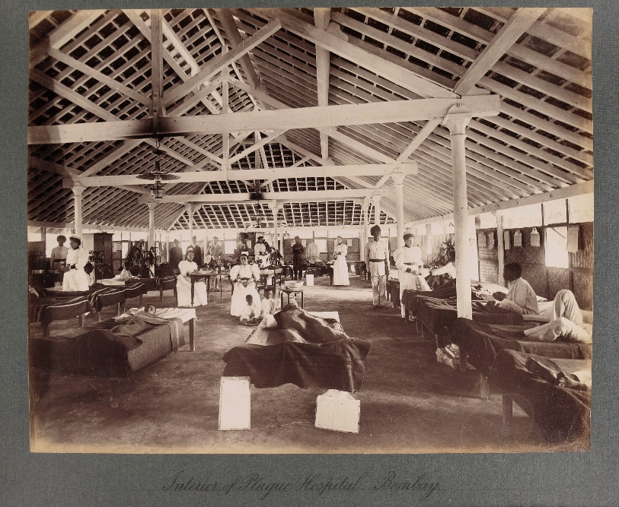
Health in Colonial India
Concerns of the British Government
Safety of their army
Safety of colonial settlers
- Till 1835 all medical services were private
- After this Government started dispensaries
- By 1880s, dispensaries were set up all major towns in Madras, Calcutta and Bombay
Largely catered to the British Officers, troops, and their families, native princes and elites
Common people largely depended on traditional systems of medicine.
Problem of health of the general masses remained untouched up to the eve of National Independence

Slide 7
The Beginnings 1940s
India became Independent in 1947-Intense Debates
Government of India accepted the Bhore Committee Recommendations-Development of Modern Medicine.
Health Planning became a responsibility of the Government.
Need for massive investments in healthcare for developing health infrastructure and medical manpower
Adopted planned model of development- Five Year Plans

Slide 8
Context of Bhore Committee
Western world witnessed the rise in importance of Keynesian economic policies giving rise to welfare states, government was responsible for public services.
Bhore Committee developed the vision for delivering a three tier public health system.
Framework designed to be government funded and delivered universal access to healthcare.
Short term goals of Bhore Committee-to be achieved in 10 years.
District should have around 25 primary health centres serving a population of 40,000 and one 30 bedded hospital to serve two PHCs.
Each PHC to have staff of nurse, four midwives, four public health inspectors, two pharmacists, one clerk and other support staff.

Slide 9
Health Survey and Development Committee 1946
Constituted by the British Government on 18th October 1943 under the under the Chairmanship of Sir Joseph Bhore(Indian Civil Service, Ahmednagar, Maharashtra)
The setting up of the Beveridge Committee in the UK in 1942 and the socialized health services Soviet Union had an important influence in the setting of the committee
This committee had a terms of reference or it was mandated to
A broad survey of the present position in regard to health conditions and health organizations in British India and,
Recommendations for future development.
It formed 5 advisory committees among its members, which include, primary health, medical relief, professional education, medical research and industrial health.
The committee took 26 months to submit the report in 1946 resulted in 206 background papers Report consists of 4 volumes totaling around 1200 pages

Slide 10
Main Findings of Bhore Committee, 1946
Main Findings of the Committee:
Health situation very poor: High Death rates: Health of women and children extremely poor; 48% of all deaths were those of children below 10 years.
Compared Indian Situation with other countries
India England
Death Rate 22.4 12.4
IMR 162 58
Life Expectancy(M) 26.9 58
Life Expectancy (F) 26.5 62.8

Slide 11
What were the causes of this low level of health in India?
Unsanitary Conditions-Sanitary measures provided in only few pockets
Poor nutrition-underweight, malnutrition because of poverty, famine and disease
Inadequacy of existing medical and preventive health organisations
Lack of general and health education-High Illiteracy
Overriding these causes were unemployment and poverty
All these were interrelated

Slide 12
Medical Manpower and Infrastructure
Medical personnel and services
1: Doctor 1: 6300 in 1942-43 while England had 1:1000
Nurse 1:43000 while England had 1:300
Hospital Bed 1: 4167, in England it was 1: 40
Severe Shortage of trained personnel
Number of hospitals and dispensaries were highly inadequate
Regional disparities-Urban/Rural disparities
75% of all doctors were in urban private practice

Slide 13
The guiding principles of the committee:
No individual should be denied adequate medical care because of the inability to pay for it. Free Health Services for All.
The health services should provide when fully developed all the laboratory, consultant and institutional facilities necessary for diagnosis and treatment
The health programme must from the beginning lay special emphasis on preventive work
Medical relief and preventive health care must be urgently provided as soon as possible to the vast rural population of the country.
The health services should be located as close to the people as possible to ensure maximum benefit to the communities served.
It also called for large scale training of health personnel.
Short term plan-10 years and long term plan-30 years-Detailed Plan on Health Infrastructure, Technology and Manpower.
Recommended that India spend 15% of its GDP on Health.

Slide 14
Appraisal of the Committee
The recommendations of the Bhore Committee provided a valuable blueprint for the health services development in India.
The committee suggested that health must be seen in an integrated manner and not in isolation, health services must be available irrespective of the paying capacity of the individuals,
It recommended to make health services easily available to the rural masses where about 90% of the population lived.
Focus on the historical injustice done to the “tiller of the soil” who pays a heavy price due to the absence of health facilities (GoI, 1946).
It called for providing “universal coverage and comprehensive health care” to the entire population in the country-free of cost.
Such a well-studied and minutely documented plan has not as yet been prepared in Independent India.

Slide 15
No Health Policy but Plans and Committees
1938: Sub-Committee on Health -Sokhey Committee
1943: Health Survey and Development Committee- Bhore Committee
1951-56: First Five Year Plan
1956-61 Second Five Year Plan
1959: Health Survey and Planning Committee-Mudaliar Committee
1961-66: Third Five Year Plan
1965: Mukherjee Committee
1966, 1967 and 1968 Annual Plans
1969-74: Fourth Five Year Plan
1973-Kartar Singh Committee
1974-Srivastava Committee
1983-National Health Policy

Slide 16
Health Planning
First two five year plans(1951-56 and 1956-61) focussed on building health infrastructure and develop adequate manpower-Medical Colleges and Hospitals-mainly in urban areas.
First Primary Health Centre in October 1952 for a population of 66,000.
Adoption of VERTICAL Health Programmes-Disease Control Programmes (Malaria, Tuberculosis, Small-Pox, Leprosy, Filaria, Cholera, Family Planning, Blindness Control, Maternal and Child Health).
Highly techno-centric in nature-Availability of miracle tools-Spraying of DDTs for Malaria and Vaccinations.
Depended on international agencies and philanthropic organisaitons for funds and technical expertise as well as supplies of chemicals and vaccines-

Slide 17
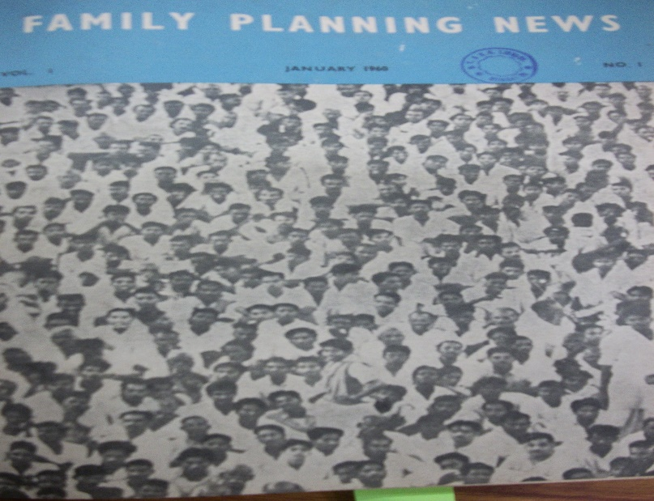
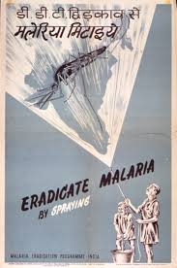
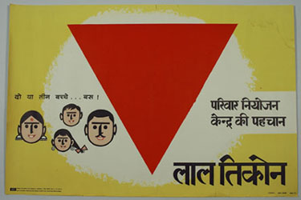
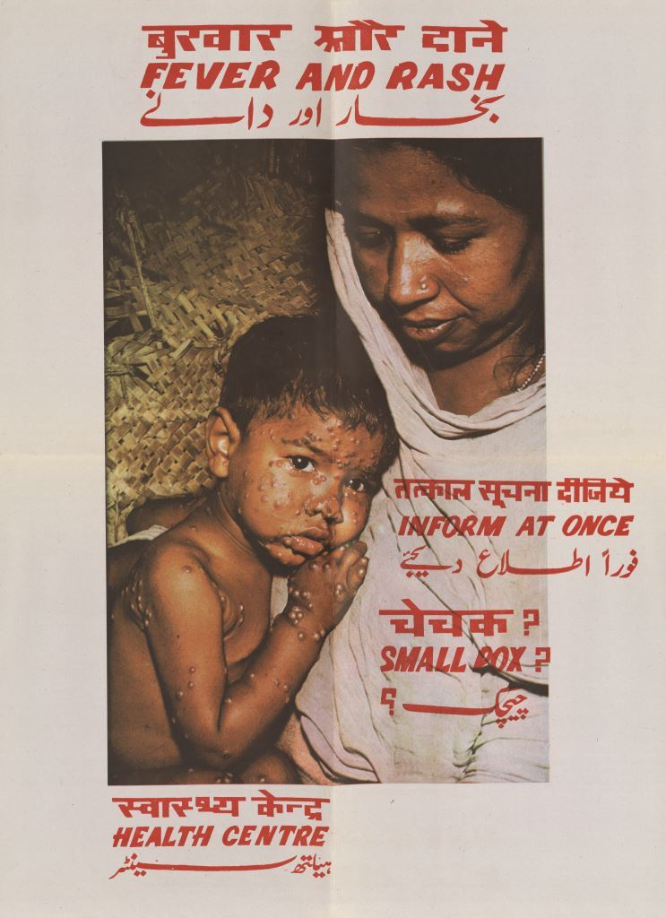
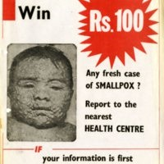
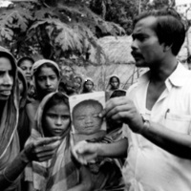

Slide 18
Unequal Access to Health Services in India
Massive expansion of health infrastructure and manpower-but unequal in nature
Concentration in urban areas and cities with a neglect of rural areas.
Dependence on doctors as the main providers of medical care.
Weak and dysfunctional health infrastructure-shortage of trained paramedical staff.

Slide 19
China’s Barefoot Doctors

Slide 20
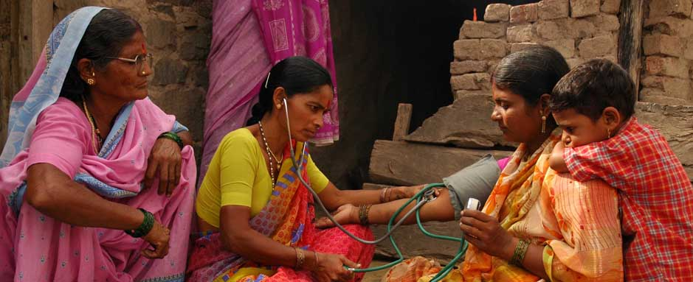
The Jamkhed Model

Slide 21
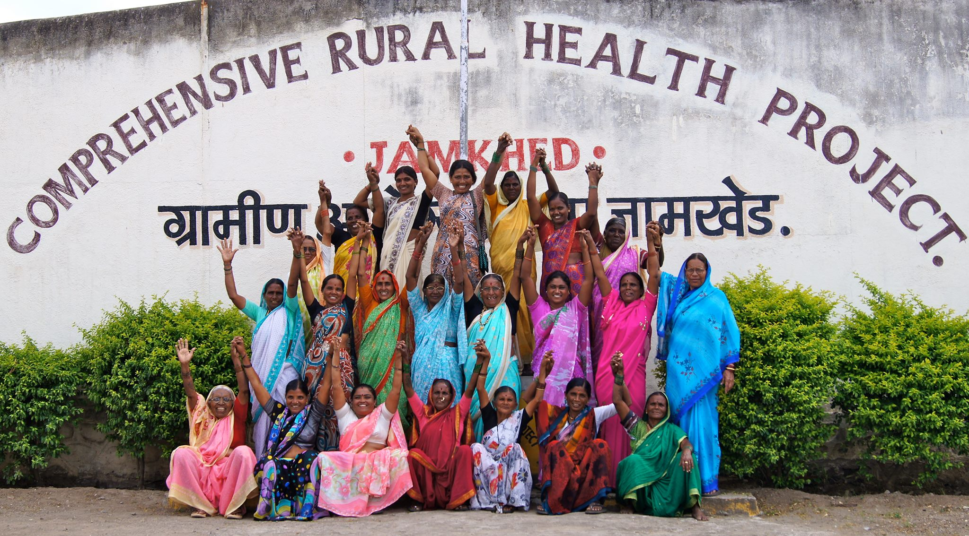
Jamkhed Model-Contd

Slide 22
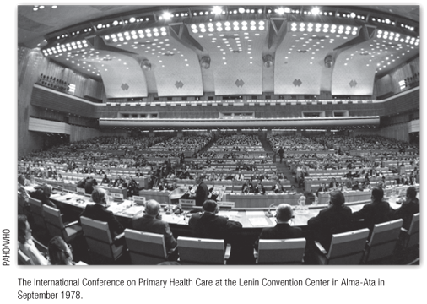
International Conference on Primary Health Care: WHO-UNICEF, Alma Ata, USSR 6th-12th September, 1978
Landmark event for Primary Health Care
3000 delegates
Representatives from 134 governments and 67 international organizations
Public Sector: health ministries, political authorities and education experts
Academics, NGOs; International and UN agencies such as ILO, FAO, USAID
Goal of Health for All by 2000 AD and Primary Health Care as a way to achieve HFA

Slide 23
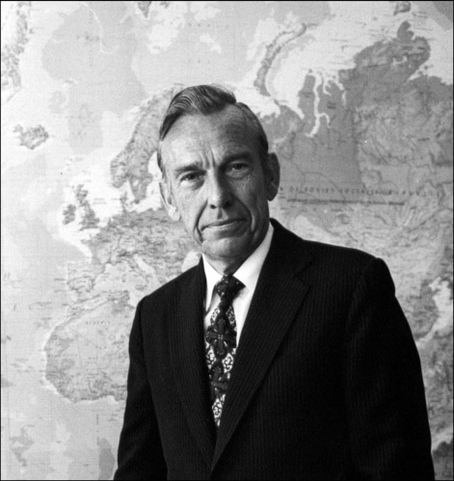
Actors
Dr Halfdan Mahler- Joined WHO in 1951;
Director General of WHO:Three terms 1973-88
Worked on Tuberculosis, India and Eucador
India-10 years (1951-60) WHO Officer at the National Tuberculosis Programme
Charismatic and Visionary Leader
UNICEF and WHO: Close relationship with Henry Labouisse UNICEF-Executive Director from 1965-79
Emphasized on community based initiatives in health and education in rural and urban slums
1975 WHO-UNICEF ‘Alternative Approaches to Meeting Basic Health Needs in Developing Countries’ PHC experiences in 9 countries

Slide 24
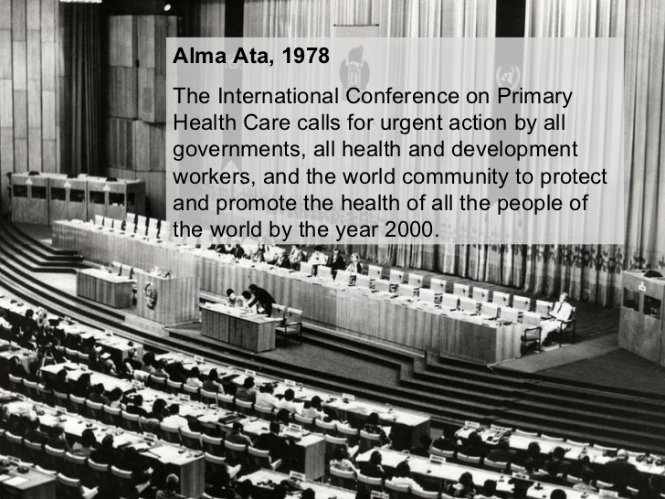
Declaration of Alma Ata-1978: Defines PHC as
Primary health care is essential health care based on practical, scientifically sound and socially acceptable methods and technology made universally accessible to individuals and families in the community through their full participation and at a cost that the community and country can afford to maintain at every stage of their development in the spirit of self-reliance and self-determination.

Slide 25
Alma Ata Declaration, 1978
Health is a fundamental human right and that the attainment of the highest possible level of health is a most important world wide social goal.
Government have a responsibility for the health of their people which can be fulfilled by the provision of adequate health and social measures
Called on all the government to formulate national health policies according to their own circumstances to launch and sustain primary health care as a part of the national health system

Slide 26
Principles of Primary Health Care
Equitable Distribution
Community Participation
Inter-Sectoral Coordination
Appropriate Technology

